Slide 1

Movie Studio Data Analysis Project
Uncovering Insights for Success in the Film Industry
Jimmy Mumo

Slide 2
Introduction
Project Overview
The aim of this project is to help the company Microsoft enter into the movie industry by giving them insights as to which movies would be a profitable venture to produce.
The aim was to look at which types of movies are currently doing well at the box office, thus allowing Microsoft to understand the market trends and thus find a preferable niche.
The data used in this project is movie ratings and box office returns

Slide 3
Business Problem
The challenge at hand is that Microsoft intends to venture into the film industry by forming a new movie studio.
To achieve this they require insights on what films perform well at the box office
These insights will allow them to make informed decisions on what content they should look into producing and thus maximizing profitability and audience engagement.

Slide 4
Data Understanding
The data for this project is sourced from Box Office Mojo, Rotten Tomatoes and The Movie Database.
The datasets are representative of movie information gathered over the course of several years including movie names, gross, cast and crew, ratings and reviews.

Slide 5
Data Preparation
In this stage, the data is preprocessed and cleaned in order to make it suitable for analysis. This ensures that the data is of a higher quality and thus will help in the process of getting insights and thus aiding the Microsoft movie studio make more informed decisions.
This stage is a crucial process that involves collecting raw data from diverse sources and transforming it into a format suitable for analysis and modeling. This multistep process includes inspecting data for issues, handling missing values through imputation or removal, cleaning data by correcting errors and inconsistencies, and transforming features for better representation.

Slide 6
Data Modelling
This stage involves the selection of criteria in order to use them in the creation of prediction models after having cleaned up the data.
At this juncture, it was found that the best profitable genre to go into is horror as most movies have rather lower production budgets and experience large box office grosses both domestically and abroad

Slide 7
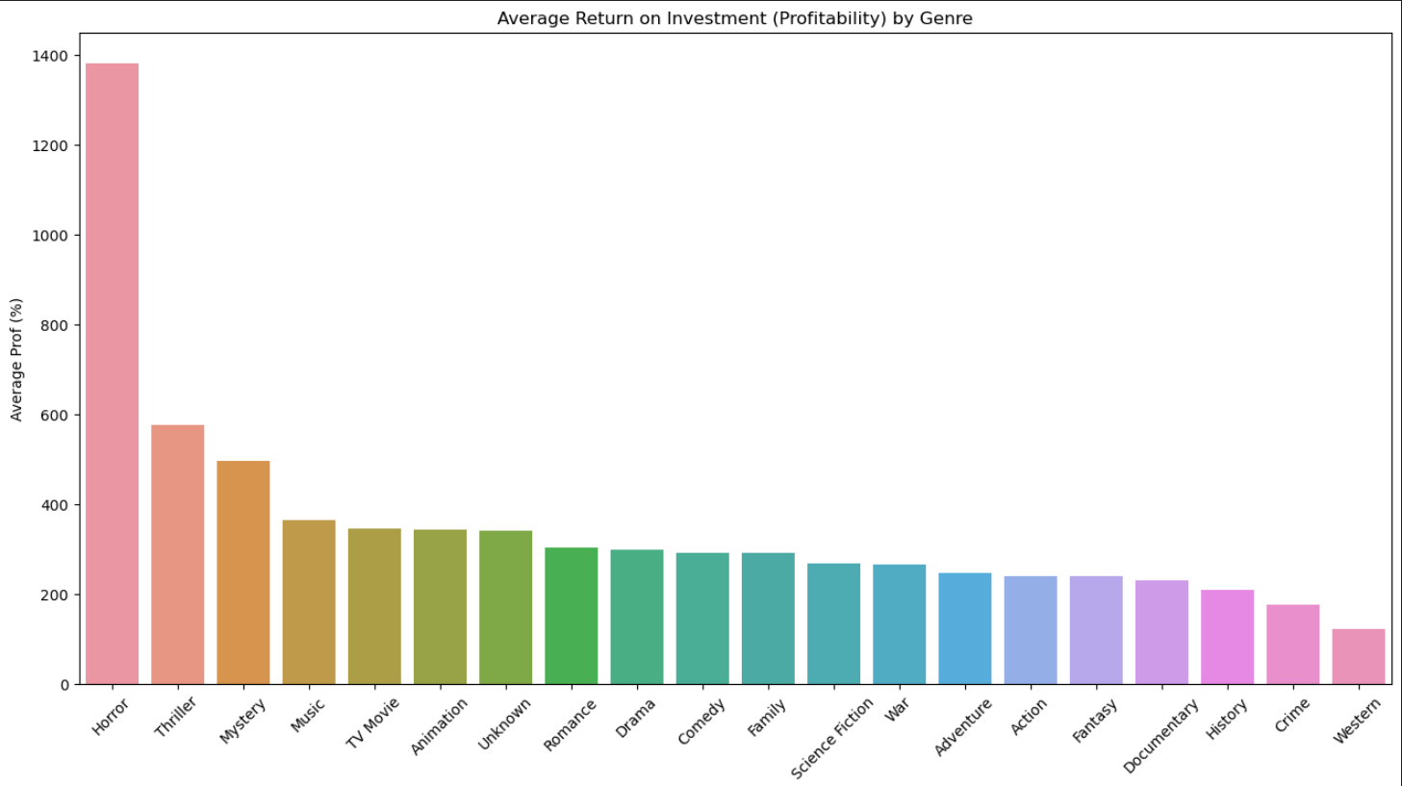
Profitability by Genre

Slide 8
Evaluation
Horror Genre Profitability:
Finding: The analysis highlights that the horror genre is exceptionally profitable, primarily due to lower production costs and positive audience reviews.
Implication: Starting a movie studio with a focus on horror films could result in significant financial success.
Uptick in Movie Trends:
Finding: The analysis reveals an upward trend in movie consumption over the years, indicating a favorable time to invest in the industry.
Implication: The current movie landscape is conducive for new entrants, with a diverse and growing audience, suggesting a resilient market.
Timing for Investment:
Finding: The analysis suggests that the timing is opportune for entering the movie industry, given the positive trend in movie consumption and evolving audience preferences.
Implication: There is a strategic window of opportunity for a new studio to establish itself and capitalize on the growing and engaged audience in the market.

Slide 9

Conclusions
The data-driven insights encourage the idea of entering the movie industry with a focus on the horror genre presents a promising opportunity for high profitability. The corresponding uptick in the industry trends further reinforces the favourable environment for new entrants.

